Slide 1
Assignment 3
Group 6:
Chengchao Fang
Chentao Han
Kai Wang
Yiran Jin

Slide 2
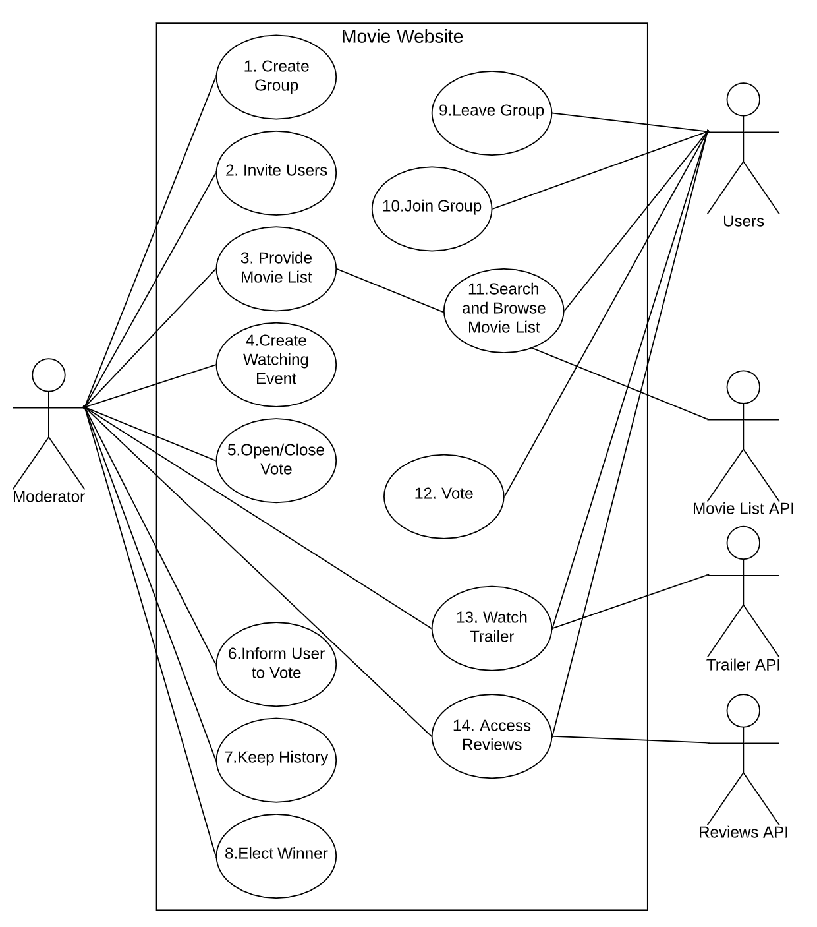
1. Use Case Diagram

Slide 3
Actors
Moderator: A host who starts whole process
Users: All users in the application
Movie List API: The interface which can provide movie list information
Trailer API: The interface which can provide trailer information
Reviews API: The interface which can provide reviews information

Slide 4
Use Case ID & Title: 1. Create Group
Author: Group 6
Date: February 10, 2020
Summary: Moderator can use this use case to create a movie watching group
Actors: Moderator
Preconditions: Moderator can access the web page which has a create group button
Postconditions: System has stored group information
Assumptions: Moderator just can create a group at one time
Exceptions: Group information loss ~ Check database storage setup

Slide 5
Use Case ID & Title: 1. Create Group
Steps:
1. User clicks ‘create group’ button
2. System receives the request
3. System displays the group register page
4. User fills the required information in the page
5. User clicks ‘create’ button
6. System receives the information
7. System checks duplicate, if no then next step, otherwise displays error and back to step 3
8. System displays new group main page

Slide 6
Use Case ID & Title: 2. Invite Users
Author: Group 6
Date: February 10, 2020
Summary: Moderator can use this use case to invite users to join a group
Actors: Moderator
Preconditions: Moderator can access the web page which has an invite button
Postconditions: Users can be invited
Assumptions: Moderator just can invite a user at one time
Exceptions: Users can’t receive invite ~ Check connection between server and client

Slide 7
Use Case ID & Title: 2. Invite Users
Steps:
1. User clicks ‘invite users’’ button
2. System receives the request
3. System displays the user invitation page
4. User fills the required information in the page
5. User clicks ‘invite’ button
6. System receives the information
7. System send a message to the invited user
8. System back to the user invitation page

Slide 8
Use Case ID & Title: 3. Provide Movie List
Author: Group 6
Date: February 10, 2020
Summary: Moderator can provide movie list for users to search and browse by API
Actors: Moderator, API
Preconditions: Moderator can access to the API
Postconditions: System can access the movie list by API
Assumptions: Moderator just can provide one movie list for one group
Exceptions: System can’t access movie list ~ Check the validation of API

Slide 9
Use Case ID & Title: 3. Provide Movie List
Steps:
1. User clicks ‘Provide movie list’ button
2. System receives the request
3. System displays the provide movie list page
4. User fills the target webpage’s URL in the page
5. User clicks ‘Create’ button
6. System receives the information
7. System show the target webpage
8. System back to the main page

Slide 10
Use Case ID & Title: 4. Create Watching Event
Author: Group 6
Date: February 10, 2020
Summary: Moderator can create a movie watching event
Actors: Moderator
Preconditions: Moderator can access the web page which has a create event button
Postconditions: System has stored event information
Assumptions: Moderator just can create an event at one time
Exceptions: Event information loss ~ Check database storage setup

Slide 11
Use Case ID & Title: 4. Create Watching Event
Steps:
1. User clicks ‘Create Watching Event’ button
2. System receives the request
3. System displays the event create page
4. User fills the required information in the page
5. User clicks ‘create’ button
6. System receives the information
7. System checks duplicate, if no then next step, otherwise displays error and back to step 3
8. System displays new event main page

Slide 12
Use Case ID & Title: 5. Open/Close Vote
Author: Group 6
Date: February 10, 2020
Summary: Moderator can open and close a voting period for a specific movie watching event
Actors: Moderator
Preconditions: Moderator can access open/close button in a movie watching event
Postconditions: Vote option is open or close
Assumptions: Moderator just can open or close vote after creating watching event
Exceptions: Open/Close vote invalid ~ Debug the program

Slide 13
Use Case ID & Title: 5. Open/Close Vote
Steps:
1. Moderator click the ‘Open/Close Vote’ button
2. System receives the request
3. System displays the choose of movie page or the vote event
4. Moderator fills the required information in the page/ choose the event to close
5. User clicks ‘create’/’close’ button
6. System receives the information
7. System checks duplicate, if no then next step, otherwise displays error and back to step 3
8. System displays the event has been created or closed, and save the change in the database

Slide 14
Use Case ID & Title: 6. Inform Users to Vote
Author: Group 6
Date: February 10, 2020
Summary: Users can be informed a movie watching event was created and they can vote for movies
Actors: Moderator
Preconditions: Moderator can access the web page which has an inform button
Postconditions: Users receive message to inform they can vote
Assumptions: Moderator can inform multiple users at the same time
Exceptions: Users can’t receive information ~ Check connection between server and client

Slide 15
Use Case ID & Title: 6. Inform Users to Vote
Steps:
1. Moderator click the ‘Inform Users to Vote’ button
2. System receives the request
3. System displays the choose of users of the vote event
4. Moderator fills the required information in the page
5. User clicks ‘inform’ button
6. System receives the information
7. System checks duplicate, if no then next step, otherwise displays error and back to step 3
8. System displays that the user has been informed

Slide 16
Use Case ID & Title: 7. Keep History
Author: Group 6
Date: February 10, 2020
Summary: Moderator can keep history of movie watching event
Actors: Moderator
Preconditions: Moderator can access the movie watching event which has keep history button
Postconditions: System has stored the history
Assumptions: A movie watching event just be kept once
Exceptions: History information loss ~ Check database storage setup

Slide 17
Use Case ID & Title: 7. Keep History
Steps:
1. Moderator click the ‘Keep History’ button
2. System receives the request
3. System displays the choices of history(vote event, group information or movie event) the moderator want
4. Moderator fills the required information in the page
5. User clicks ‘Get History’ button
6. System receives the information
7. System checks duplicate, if no then next step, otherwise displays error and back to step 3
8. System get the information from database and displays that the history the moderator want

Slide 18
Use Case ID & Title: 8. Elect Winner
Author: Group 6
Date: February 10, 2020
Summary: Moderator can elect a winner of movies in each movie watching event according to users’ vote
Actors: Moderator
Preconditions: Moderator can access the vote information to elect a winner
Postconditions: System storing the winner
Assumptions: A movie watching event just has one winner
Exceptions: Moderator can’t get vote information ~ Check connection between server and client

Slide 19
Use Case ID & Title: 8. Elect Winner
Steps:
1. Moderator click the ‘Elect Winner’ button
2. System receives the request
3. System get the vote information from the database, and automatically come out the most voted movie
4. System display the winner information to the moderator

Slide 20
Use Case ID & Title: 9. Leave Group
Author: Group 6
Date: February 10, 2020
Summary: Users can leave a group
Actors: Users
Preconditions: Users can access the web page which has a leave button
Postconditions: The user is not in the current group
Assumptions: The user can not leave group before joining
Exceptions: The user is still in group after leaving ~ Debug the program

Slide 21
Use Case ID & Title: 9. Leave Group
Steps:
1. User clicks ‘leave group’ button
2. System receives the request
3. System displays the confirmation page
4. User can choose leave group or not
5. User clicks ‘leave’ button
6. System receives the information and delete the user from the group
7. The user leaves the group

Slide 22
Use Case ID & Title: 10. Join Group
Author: Group 6
Date: February 10, 2020
Summary: Users can be informed a movie watching event was created and they can vote for movies
Actors: Moderator
Preconditions: Users can receive the invite message
Postconditions: System stores the user in the current group
Assumptions: A user just can join a group at one time
Exceptions: Users can not receive the invite ~ Check the connection between server and client

Slide 23
Use Case ID & Title: 10. Join Group
Steps:
1. User receives invite from moderator
2. User receives a message from moderator says do you want to join a group
3. The page shows join or refuse
4. User clicks ‘join’ button’
5. System receives the information and add the user to the group
6. The user joins the group

Slide 24
Use Case ID & Title: 11. Search and Browse Movie List
Author: Group 6
Date: February 10, 2020
Summary: Users can be informed a movie watching event was created and they can vote for movies
Actors: Moderator
Preconditions: Users can access to the movie list
Postconditions: Users can search and browse the movie list
Assumptions: Every user in the group can access the movie list
Exceptions: Users can’t access movie list ~ Check the validation of API

Slide 25
Use Case ID & Title: 11. Search and Browse Movie List
Steps:
1. User clicks ‘movie list ‘ button
2. System receives the request
3. System displays the movie list page
4. User clicks ‘search’ button
5. User can search and browse movies in that page

Slide 26
Use Case ID & Title: 12. Vote
Author: Group 6
Date: February 10, 2020
Summary: Users can be informed a movie watching event was created and they can vote for movies
Actors: Moderator
Preconditions: Users can receive the informed message
Postconditions: Users can have a vote and moderator can get the feed back
Assumptions: A user just can vote once
Exceptions: Moderator can’t get the feedback ~ Check the connection between server and client

Slide 27
Use Case ID & Title: 12. Vote
Steps:
1. User is informed from moderator that they can vote
2. User votes for the movie they like
3. System receives the information
4. System transmit the information to moderator

Slide 28
Use Case ID & Title: 13. Watch Trailer
Author: Group 6
Date: February 10, 2020
Summary: User can watch trailers of movie provided by API
Actors: Moderator, API, Users
Preconditions: Users can access to the trailer watching event
Postconditions: Users can watch trailer provided by API
Assumptions: Multiple users can watch the same trailer at the same time
Exceptions: Users can’t access movie trailer ~ Check the validation of API

Slide 29
Use Case ID & Title: 13. Watch Trailer
Steps
1. User clicks ‘watch trailer’ button
2. System receives the request
3. System displays the trailer page

Slide 30
Use Case ID & Title: 14. Access Reviews
Author: Group 6
Date: February 10, 2020
Summary: User can access reviews of movies provided by API
Actors: Moderator, API, Users
Preconditions: Users can access to the reviews watching event
Postconditions: Users can watch reviews provided by API
Assumptions: Multiple users can watch the same reviews at the same time
Exceptions: Users can’t access movie reviews ~ Check the validation of API

Slide 31
Use Case ID & Title: 14. Access Reviews
Steps
1. User clicks ‘review’ button
2. System receives the request
3. System displays the review page

Slide 32
2. Use Case Specification
1. Create Group: When moderator wants to launch an event. Moderator can create a group firstly through clicking the button named “Create Group”. If the system return success, create successfully, else the system return fail, create fail.
2. Invite User: Moderator can click button named “Invite Users” when they want to invite some people to the group, then input the ID of who he/she want to invite in. If the system return success, invitation submit successfully, else return fail.
3. Provide Movie List: After moderator create a group, he/she needs to get a movie list from API, he/she click the “Get Movie List” button, then the system return success, import the movies’ names resources successfully, else return fail.
4. Create Watching Event: After moderator create groups, he/she needs to choose the time and situation he/she wants to organize this event. Through clicking the button named “Create Event” and then input the information of event. System return success, create successfully, else return fail.
5. Open/Close Vote: Once the moderator finish creating movie list, he/she can open vote immediately, then some days later, he/she can close vote. When he/she click button names “Open/Close Vote”, system return success, open/close successfully, else return fail.

Slide 33
2. Use Case Specification
6. Inform User To Vote: When moderator open the vote function, he/she can choose to inform users to do a vote, he/she click button named “Inform User”, system return success, inform successfully, and the system will send message to users, else return fail.
7. Keep History: When vote finish, moderator can choose to save the information about this event and vote data through clicking button named “Keep History”, system return success, save successfully, else return fail.
8. Elect winner: After moderator close the vote, he/she need to choose a winner movie, so he/she can click the button named “Elect Winner”, the system return the winner name if run successfully, else return fail.
9. Leave Group: Users can leave the group when they do not or cannot join the group event. User just need to click the button named “Leave Group”, system return success, user leave the group successfully, else return fail;
10. Join Group: When user receive an invitation from moderator, he/she can choose whether join this group, if they want to join this group, click the button named “Accept”, system return success, user join group successfully, else return fail. If user do not want to join this group, he/she click button “Refuse”.

Slide 34
2. Use Case Specification
11. Search and Bowser Movie List: After moderator provide movie list, users in this group can search and browser movie list through click “Movie List” button, the web page will jump to the movie list page, and users can search some key words to search.
12. Vote: After moderator open the vote function, user can vote his/her favorite movies by choose the movie and then click button “Submit”, system return success, submit successfully, else return fail.
13. Watch trailer: When user search and bowser the movie list, they can watch trailer which movie they want to know get more information such as watch trailer through API. He/She can just click the movie they the web will jump to the target page.
14. Access reviews: When user search and bowser the movie list, they can watch trailer which movie they want to know get more information such as read reviews through API. He/She can just click the movie they the web will jump to the target page.

Slide 35
3. Bi-direction traceability matrix
Requirement Traceability Matrix (RTM) is a table (mostly a spreadsheet) that shows if each requirement has a respective Test case/cases to make sure if the requirement is covered for testing.It is basically used to ensure that ALL the requirements and Change Requests are or will be tested.
Our traceability matrix table includes Test Case ID Description table and overall table.

Slide 36
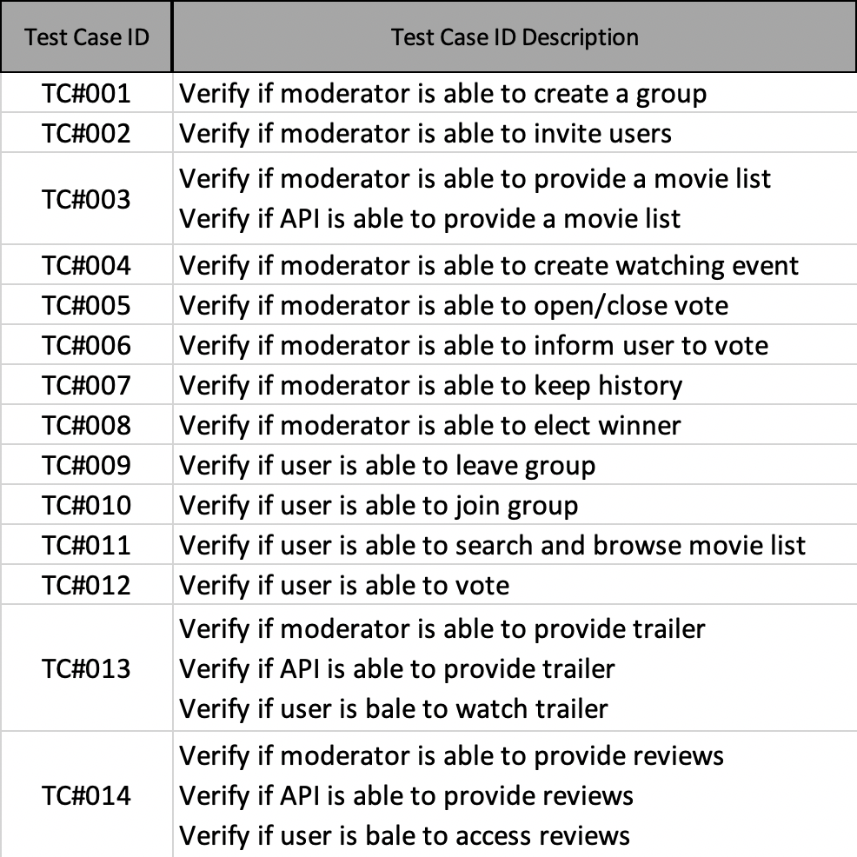
Test Case ID Description table

Slide 37
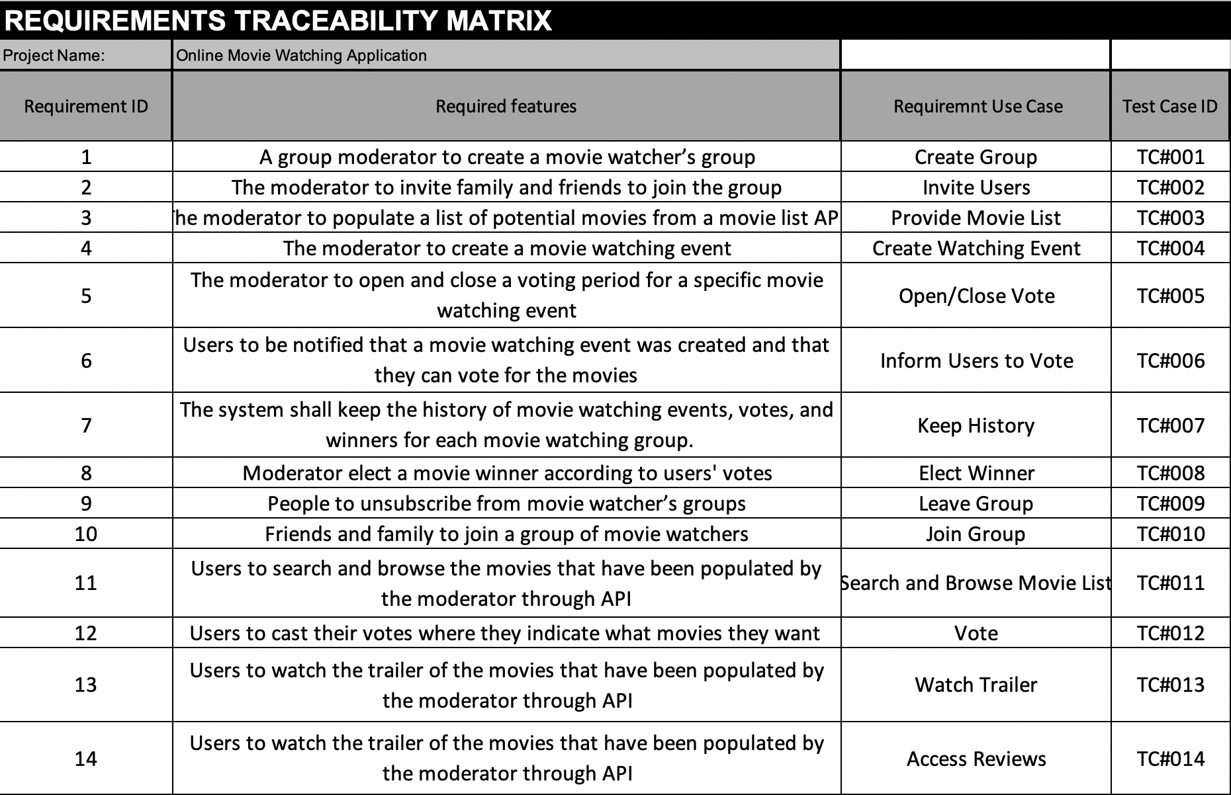
Overall table

Slide 38
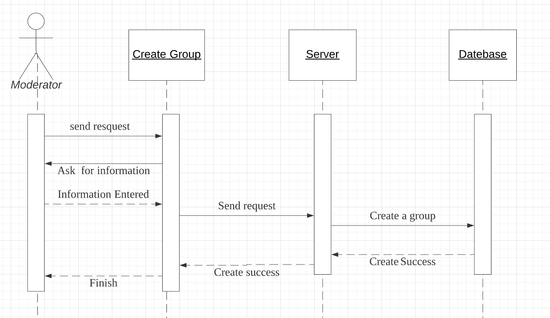
4.Sequence Diagram for Each Use Case
Create Group

Slide 39
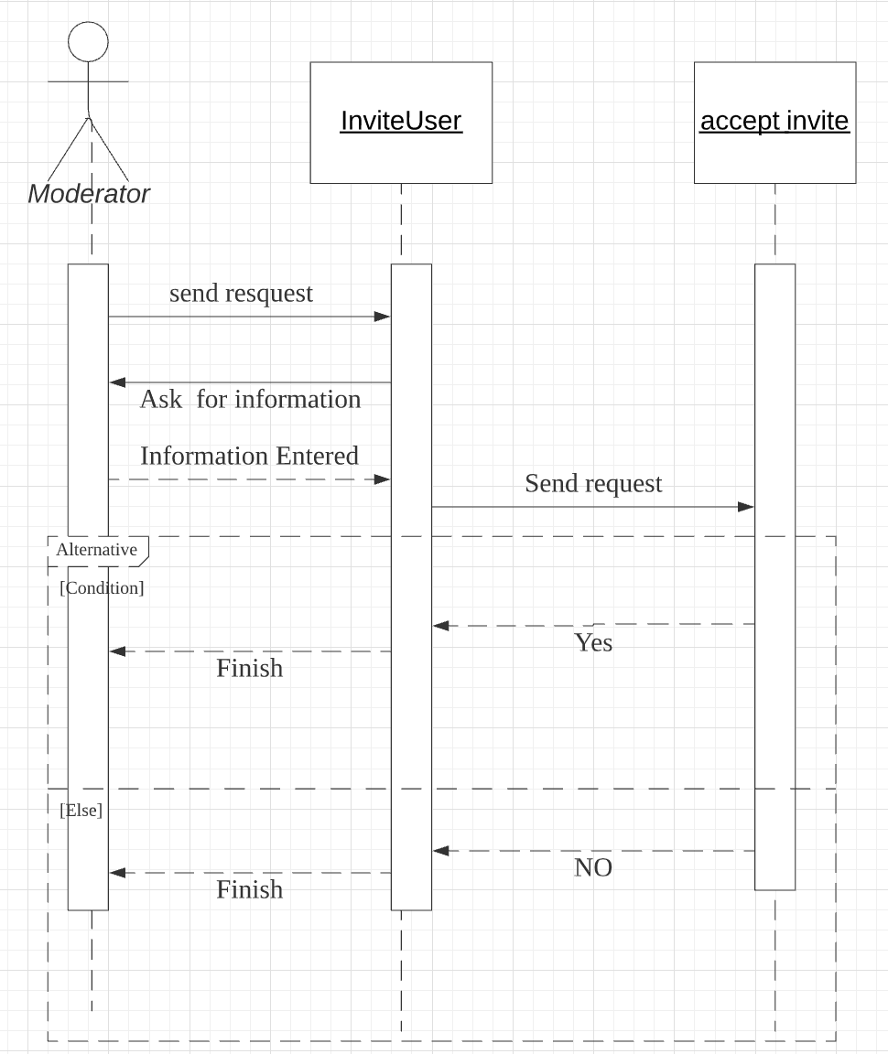
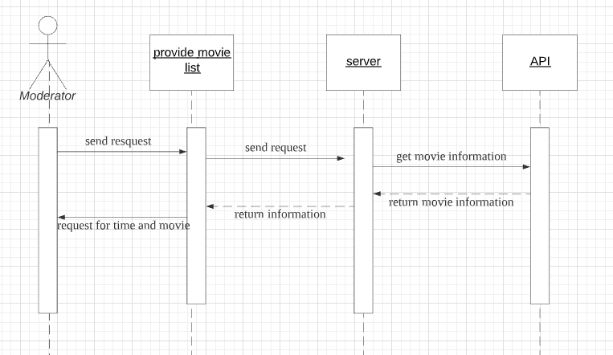
Sequence Diagram
Provide movie list
Invite
users

Slide 40
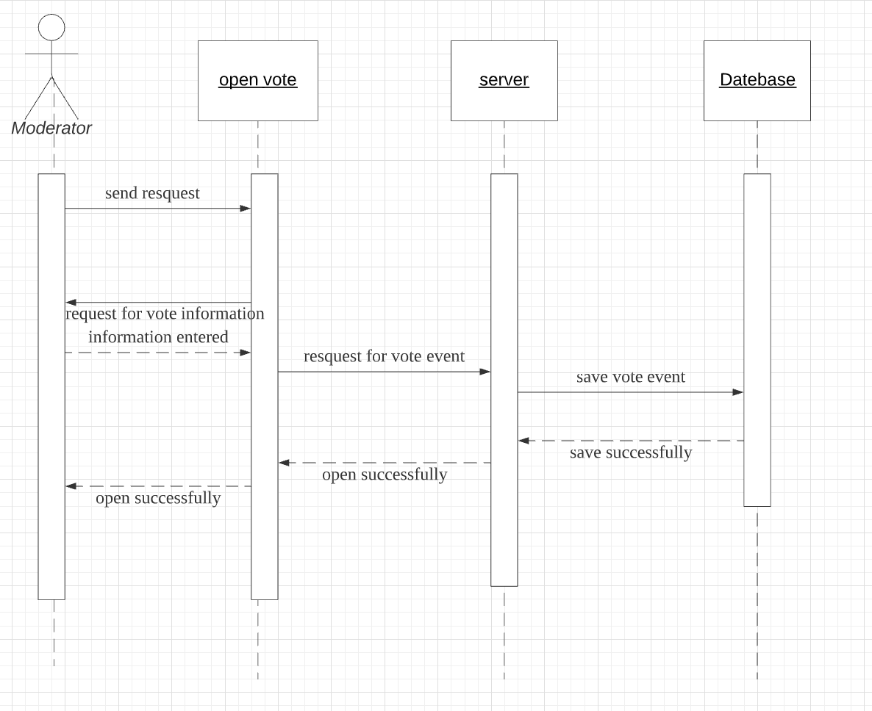
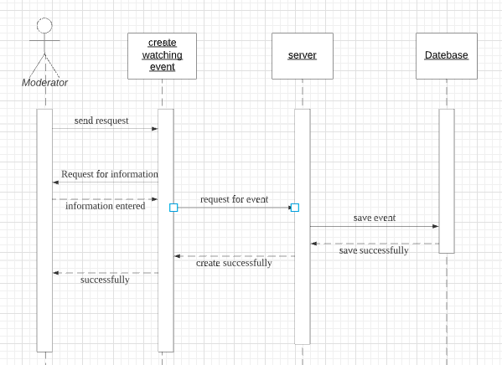
Sequence Diagram
Create watching event
Open vote event

Slide 41
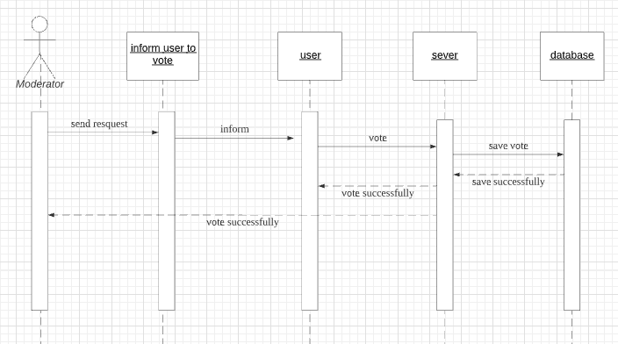
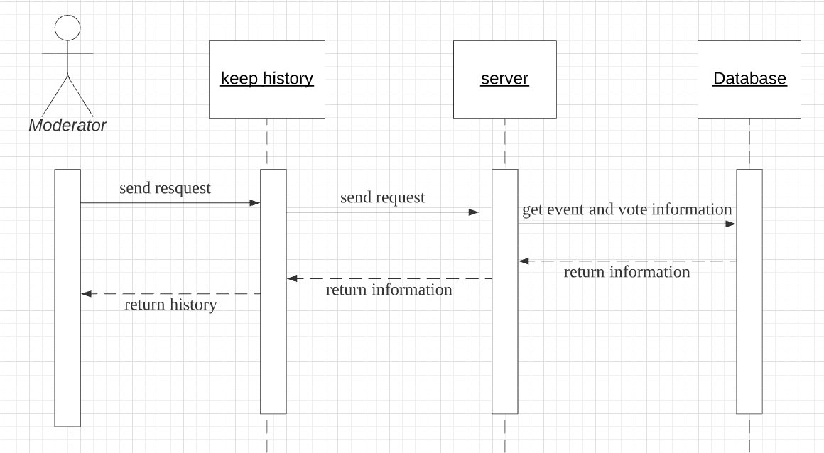
Sequence Diagram
Keep history
Inform user to vote

Slide 42
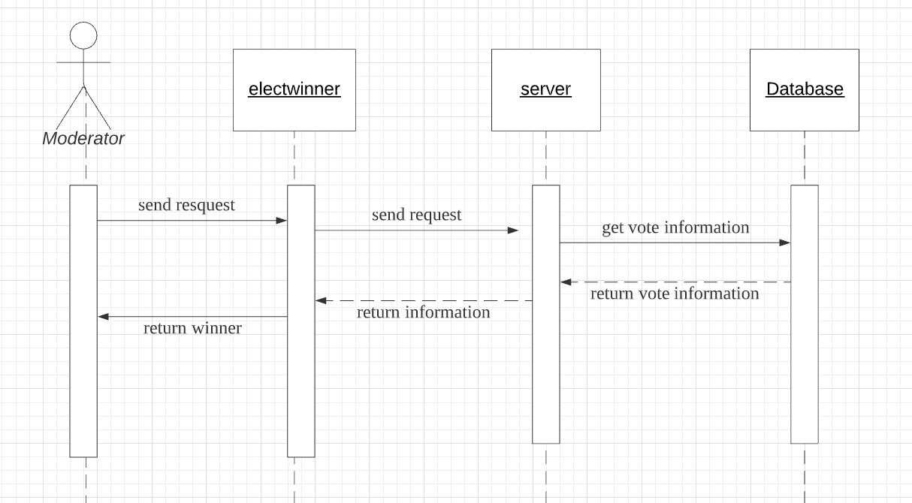
Sequence Diagram
Elect winner

Slide 43
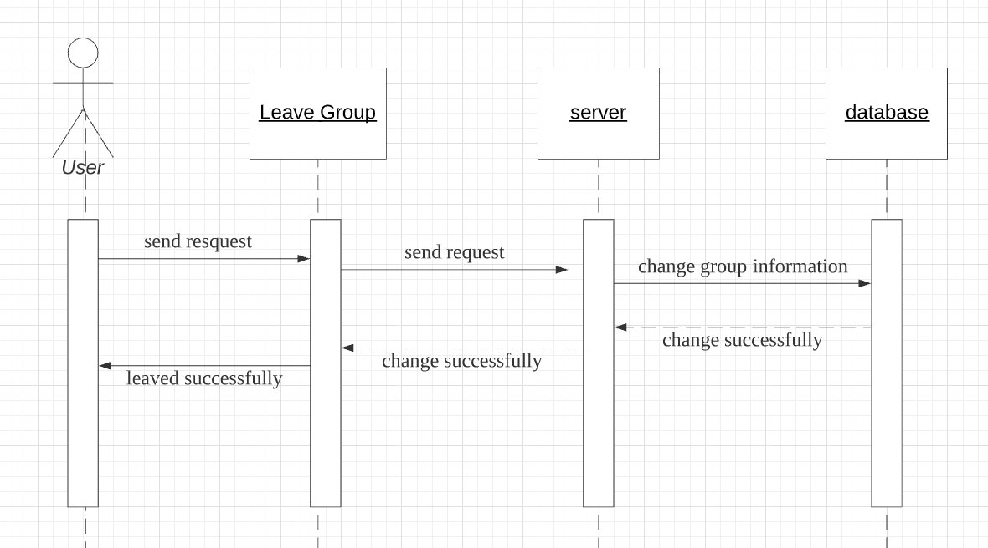
Sequence Diagram
Leave a group

Slide 44
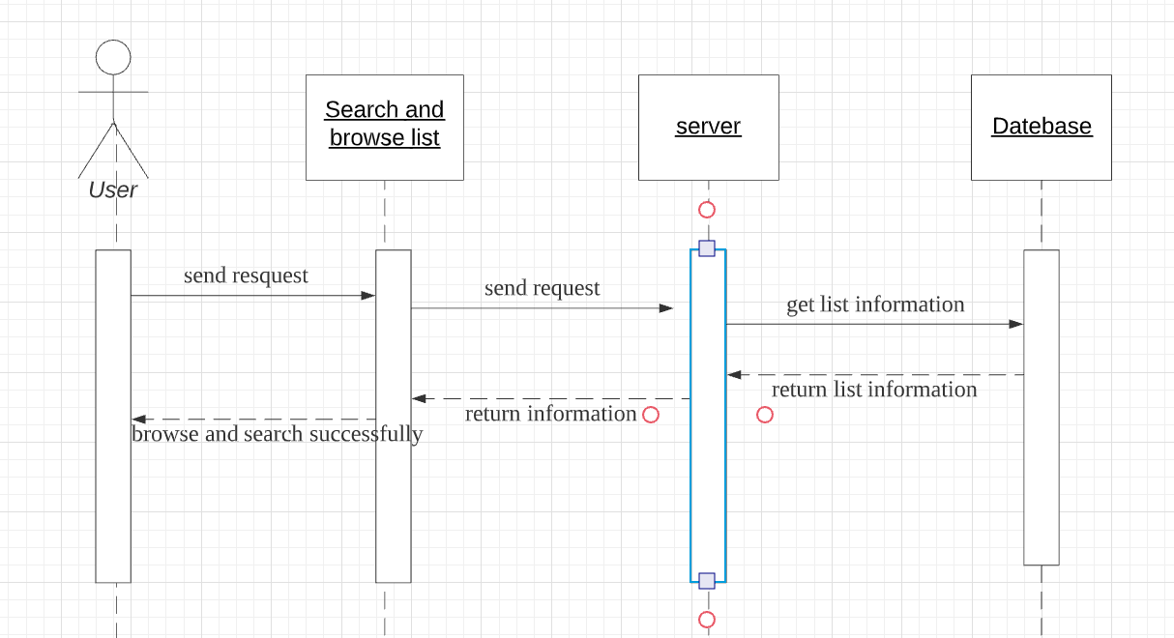
Sequence Diagram
Search and browse list

Slide 45
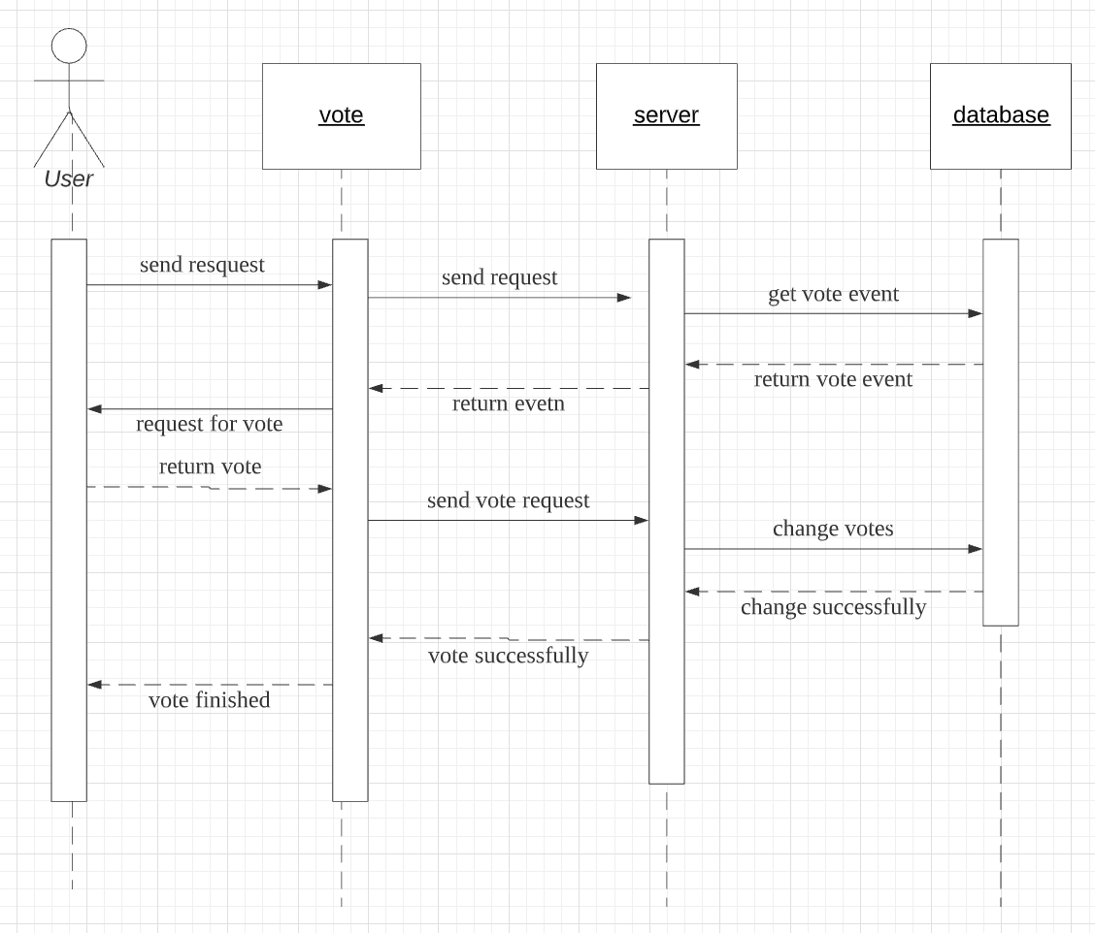
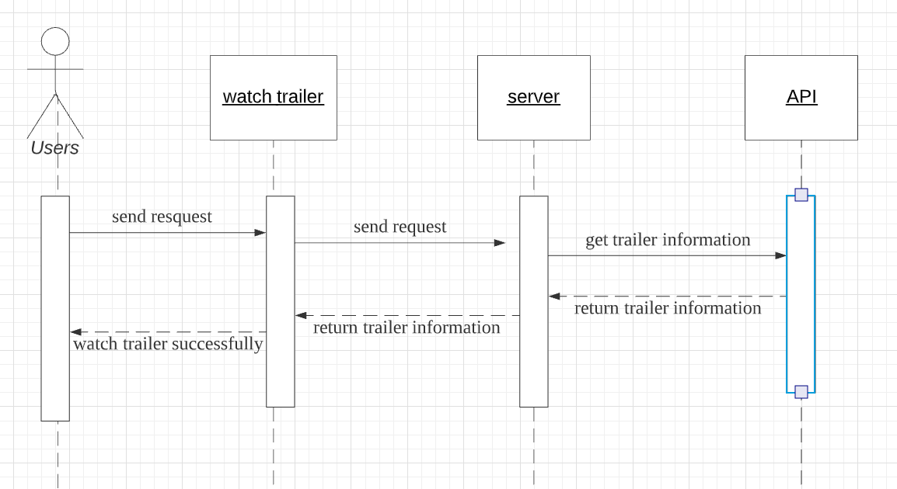
Sequence Diagram
Watch trailer
vote

Slide 46
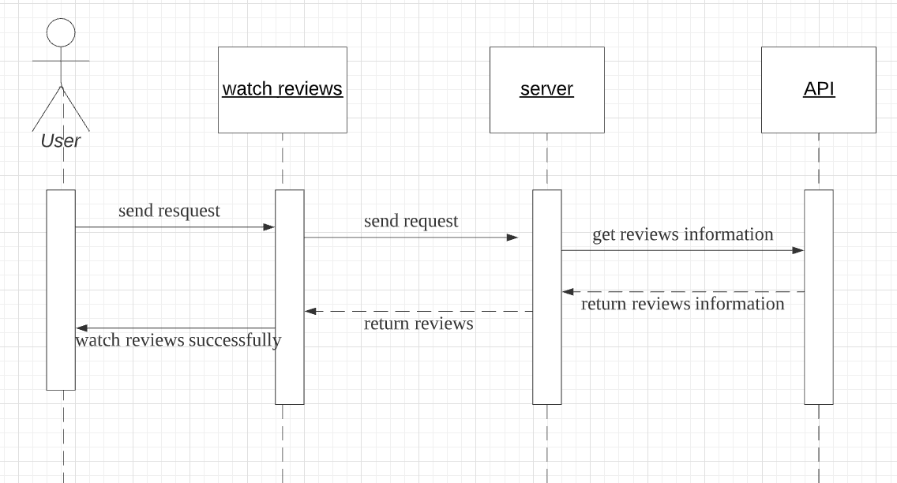
Sequence Diagram
Watch reviews

Slide 47
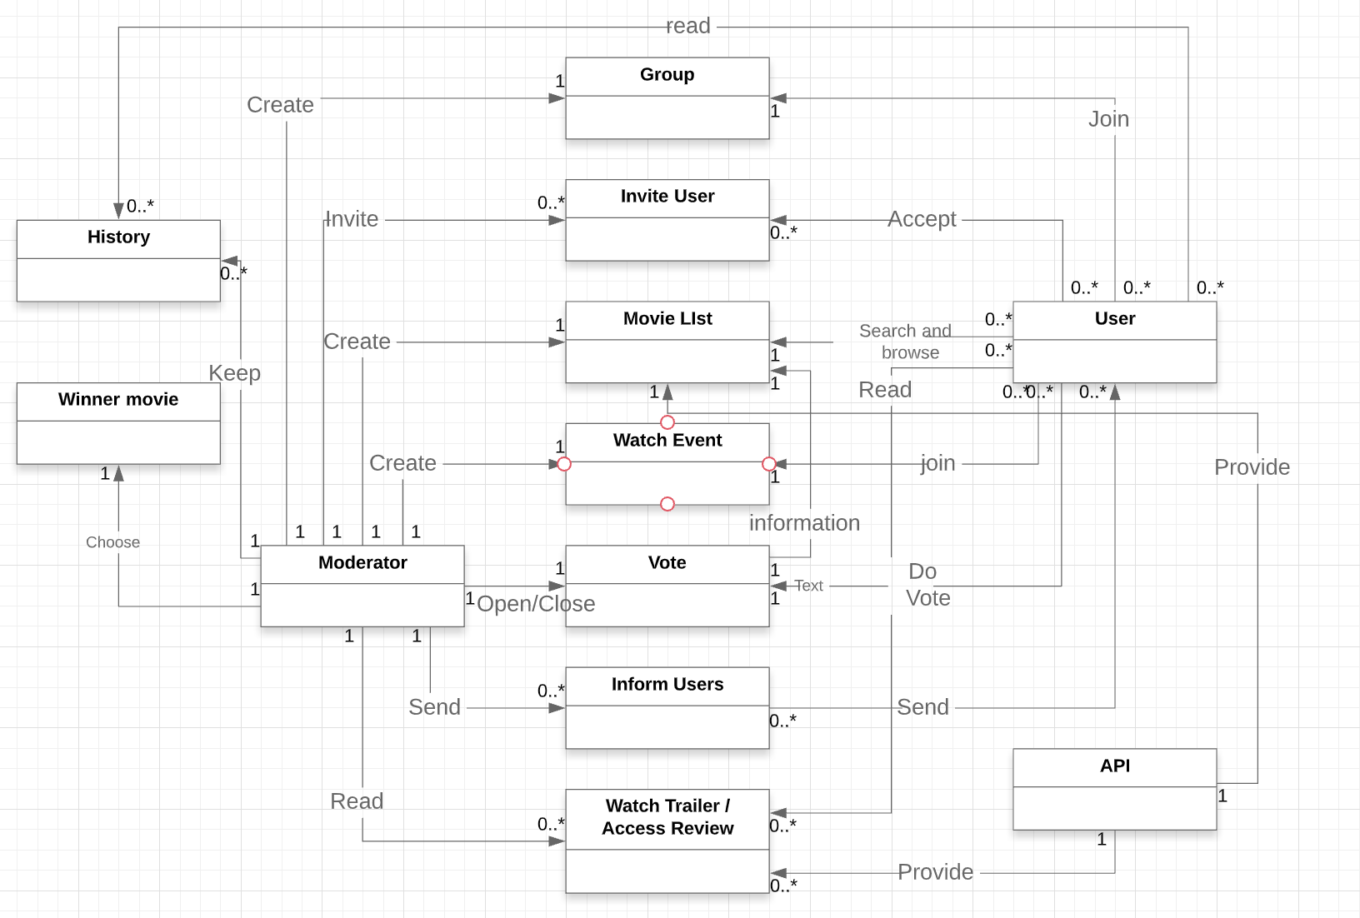
5. Class
Diagram
Modle

Slide 48
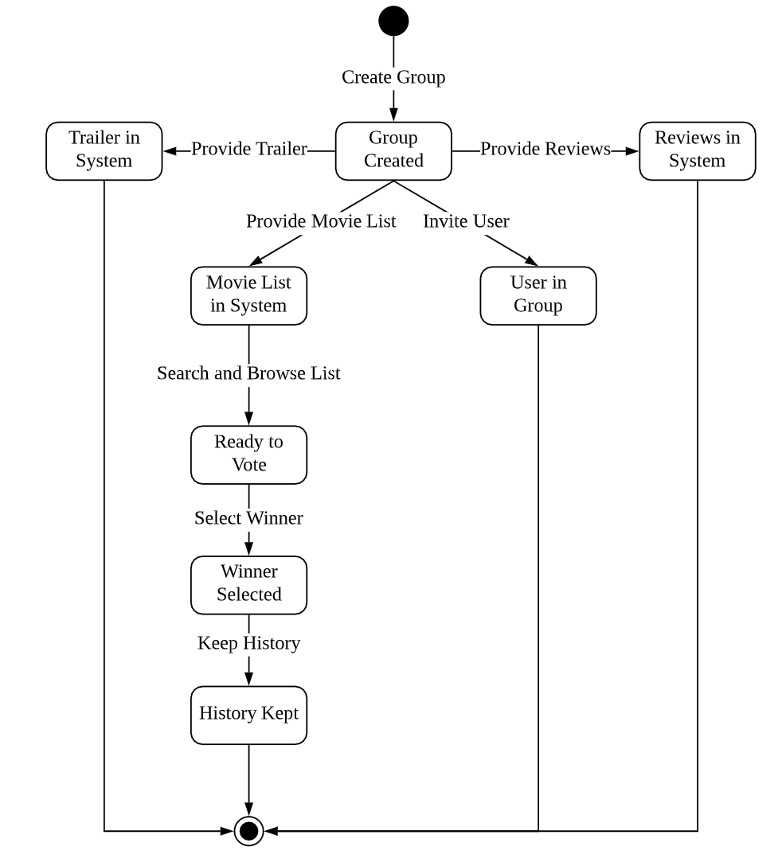
6. State Diagram
For Moderator
Class

Slide 49
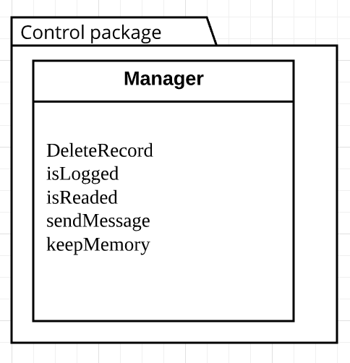
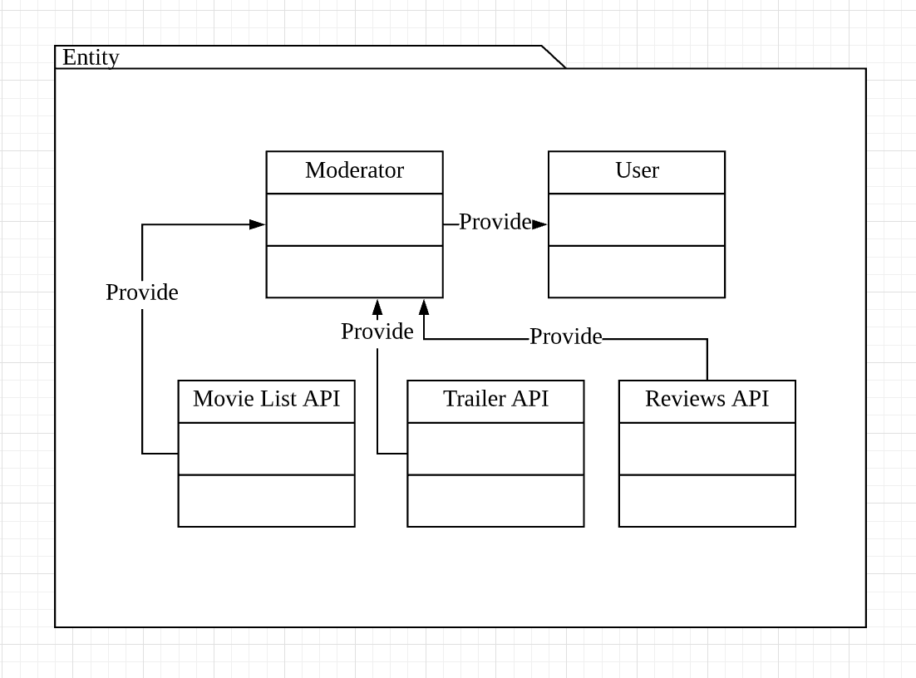
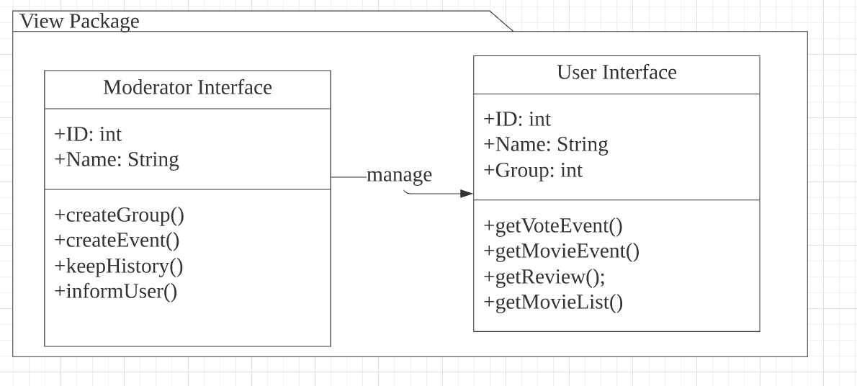
7. UML packages

